Slide 1
Getting off to the Right Start with the Texas-Mother Friendly Worksite Program
Tecora Smith, WIC Director
Northeast Texas Public Health District

Slide 2
Public Health Case for Worksite Lactation Support
For every 597 women who optimally breastfeed, one maternal or child death is prevented
More than $17 billion saved annually in health care costs and lost productivity
Source: Bartick MC, Schwarz EB, Green BD, Jegier BJ, Reinhold AG, Colaizy TT, Bogen DL, Schaefer AJ, Stuebe AM. Suboptimal breastfeeding in the United States: Maternal and pediatric health outcomes and costs. Matern Child Nutr. 2016 Sep.
Notes:
A study completed in 2016 examined the impact of optimal breastfeeding on health outcomes, and found that for every 597 women…. The definition of optimal breastfeeding, per the American Academy of Pediatrics, is exclusive breastfeeding for about the first six months of a baby’s life. When I say exclusive breastfeeding I mean an infant being fed only breast milk (so not formula or a combination) This study also indicated that more than $17 billion a year could be saved in health care costs and lost productivity…
https://www.aap.org/en-us/about-the-aap/aap-press-room/pages/aap-reaffirms-breastfeeding-guidelines.aspx

Slide 3
Breastfeeding Support: The Public Health Case
Increased breastfeeding could prevent more than 700 U.S. child deaths/year in the U.S.…
(Mostly from SIDS and NEC)
Bartick MC, Schwarz EB, et al.. Suboptimal breastfeeding in the United States: Maternal and pediatric health outcomes and costs. Matern Child Nutr. 2016

Slide 4
And could prevent an estimated
8,487 heart attacks and 986 resulting deaths* (strong evidence-more studies needed)
5,023 cases of breast cancer and 838 resulting deaths
12,302 cases of Type 2 diabetes and 473 resulting deaths
35,982 cases of hypertension and 322 resulting deaths
among U.S. women per year

Slide 5
Women Want to Breastfeed
opportunity gap
Source: CDC National Immunization Survey (NIS) 2016-2017, among 2015 births.
Notes:
87% of WIC population as of June 2018

Slide 6
The Issue
Return to work is the leading barrier to breastfeeding among working mothers
62% of women with births in the last 12 months are in the U.S. labor force
63% report: Main reason for not breastfeeding among TX WIC working moms’ who did not breastfeed was need to return to work
56% of TX WIC working moms’ main reason for early weaning was related to work
58% of a TX WIC working moms report not meeting their
own breastfeeding goals
U.S. Census Bureau, 2013 American Community Survey 1-year estimates chart by the Women’s Bureau, U.S.. Department of Labor. Available https://www.dol.gov/wb/stats/Fertility.htm
DSHS. Texas WIC Infant Feeding Practices Survey. 2016 http://dshs.texas.gov/wichd/bf/surveysreports.aspx

Slide 7
The Solution

Slide 8
Business Case for Worksite Lactation Support
Work-Life Benefits:
↑ postpartum return-to-work
Reduced turnover
Increased ability to focus on job responsibilities
Greater sense of work-life balance
Higher job satisfaction and increased loyalty
Health Benefits:
Fewer/less severe childhood illnesses & ↓ costs
Fewer absences of mothers and fathers
Source: U.S. Department of Health and Human Services, Health Resources and Services Administration (HRSA), Maternal and Child Health Bureau , Business Case for Breastfeeding, 2008.

Slide 9
What are lactation breaks?
Definition: Basic arrangements that allow mothers to comfortably express and store breastmilk and maintain lactation when separated from their babies during the work day.

Slide 10
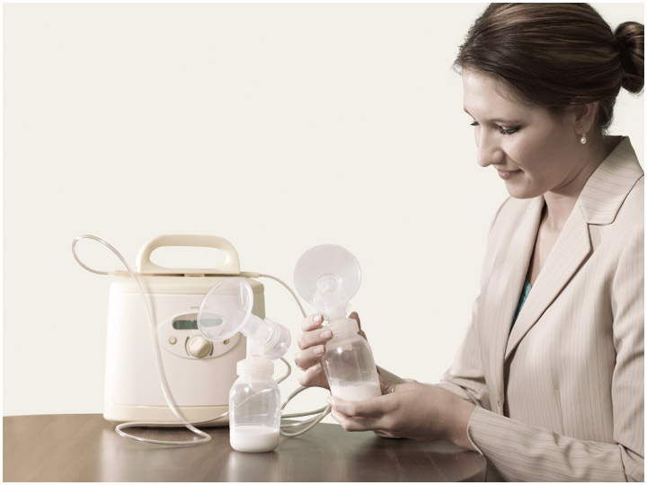
Why are lactation breaks important?
Breaks for lactation are similar to other work breaks to attend to physical needs.
When a breastfeeding mother and child are separated for more than a few hours, the woman must express milk in order to maintain milk production.
Missing even one needed pumping session can lead to decreased milk production and other undesirable consequences.
Notes:
In general, women need 30 minutes (15 to 20 minutes for milk expression, plus time to get to and from a private space and to wash hands and equipment) approximately every 2 to 3 hours to express breastmilk or to breastfeed.
Needs may vary from women to women and over the course of the breastfeeding period.
Breaks for lactation are similar to other work breaks (attend to physical needs):
Time to eat/drink, restroom breaks, accommodation for health needs (e.g. diabetes)
When mother and child are separated for more than a few hours, the woman must express milk.
Missing even one needed pumping session can have undesirable consequences: Discomfort – Leaking – Inflammation – Infection – Decreased Milk Production -- Breastfeeding Cessation

Slide 11
Texas Mother-Friendly Worksite Criteria
Written and communicated employee breastfeeding support policy
Work schedule flexibility
& break time
Accessible, private space, other than a bathroom
Access to hygienic storage
Access to clean, safe water source
Designation and Recognition
3,000 +
worksites already designated!
Notes:
Gray coloring:
The Texas Mother-Friendly Worksite Program was developed by the Texas Department of State Health Services (DSHS) in 1995 in adherence with Texas Health and Safety Code 165. Breastfeeding as one of many efforts to support women in reaching their personal breastfeeding goals by encouraging employers to develop a worksite lactation support program and be recognized for their efforts through a Mother-Friendly Worksite Designation. The designation requires employers to have a written policy highlighting four different criteria: work schedule flexibility, access to clean, safe water source, lactation space (other than a bathroom) and access to storage. To date we’ve designated over 2600 worksites in Texas.
Sec. 619.003. POLICY ON EXPRESSING BREAST MILK. (a) A public employer shall develop a written policy on the expression of breast milk by employees under this chapter.
(b) A policy developed under Subsection (a) must state that the public employer shall:
(1) support the practice of expressing breast milk; and
(2) make reasonable accommodations for the needs of employees who express breast milk.
A policy…must state that the public employer shall:
(1) provide a reasonable amount of break time for an employee to express breast milk each time the employee has need to express the milk; and
(2) provide a place, other than a multiple user bathroom, that is shielded from view and free from intrusion from other employees and the public where the employee can express breast milk.
Prohibits discrimination for asserting the right
States that no cause of action is created
"The Texas Mother-Friendly Worksite Technical Assistance and Support Program (TMFW-TASP) is a program of the Texas Department of State Health Services (DSHS) and is administered by the Michael & Susan Dell Center for Healthy Living at the UTHealth School of Public Health in Austin. TMFW-TASP was established in 2015 to encourage and assist employers to develop worksite lactation support programs and be recognized for their efforts through the Mother-Friendly Worksite designation. The Texas Mother-Friendly Worksite designation demonstrates a proactive and basic level of support for nursing mothers in the workplace, though those worksites which go beyond basic criteria can be awarded Silver- or Gold-level designations. In addition to providing technical assistance and support to worksites across Texas which are seeking the designation, TMFW-TASP also provides targeted outreach, conducts evaluations to inform public health practice, and holds promotional events to reach new worksites across employment sectors and geographic regions statewide."

Slide 12
STEPS to Supporting Employees with Worksite Lactation

Slide 13
Recommended Components
Space
Time
Education
PromotionPolicies Protocols
Support
Notes:
+ promotion
Place = space

Slide 14
Minimum Requirements
“a place, other than a bathroom, that is shielded from view and free from intrusions by co-workers and the public” to allow employees to express milk. Employers are “not obligated to maintain a permanent, dedicated space for nursing mothers”
A temporary space that has been created or converted to meet privacy requirements will suffice.
At a minimum, the space provided “must contain a place for the nursing mother to sit, and a flat surface, other than the floor, on which to place the pump”
U.S. Department of Labor. Reasonable Break Time for Nursing Mothers provision of Section 7 of the U.S. Fair Labor Standards Act

Slide 15
Minimum Requirements
Safe, clean, comfortable environment
Lock on door/badge entry/key pad OR signage and well-communicated policy
Access to nearby clean water source and a sink for hand and pump equipment hygiene
Options for safe, clean, temperature controlled milk storage

Slide 16
Options for Place: Privacy for Milk Expression
Designated, permanent space with a chair, sink, and electrical outlet
Private locked office, conference room, or other space
Lactation room set up in small office space
Space designated with a sign or reserved on a calendar that rotates throughout the workspace between offices, conference rooms, clinic rooms, etc.

Slide 17
Source: American Institute of Architects, Best Practice: Recommendations for designing lactation/wellness rooms:
https://www.aia.org/best-practices/17116-recommendations-for-designing-lactationwelln
1. task chair
2. counter (fridge underneath)
3. counter for pump
4. sink (cold and hot water dispenser)
5. tilt mirror
6. paper towel dispenser (trash can underneath)
7. electrical outlet (above the counter)
8. coat hooks
9. door for privacy

Slide 18
Permanent Space—Converted Closet
Photo Credit: OWH Employer Solutions

Slide 19
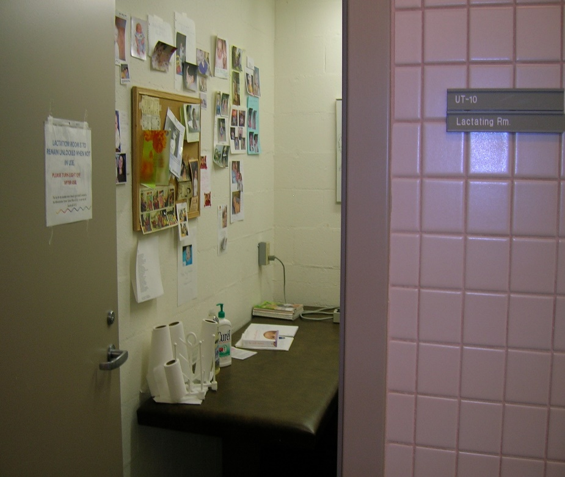
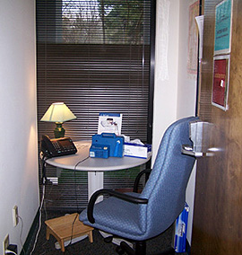
Options for Place: Room Options
Photo credit: Centers for Disease Control and Prevention
Photo credit: Cate Colburn-Smith

Slide 20
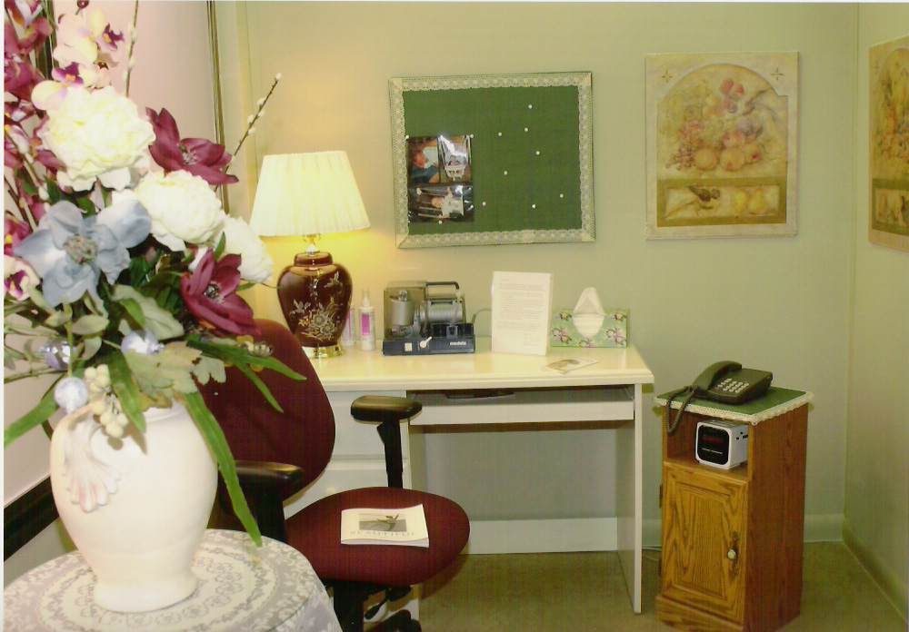
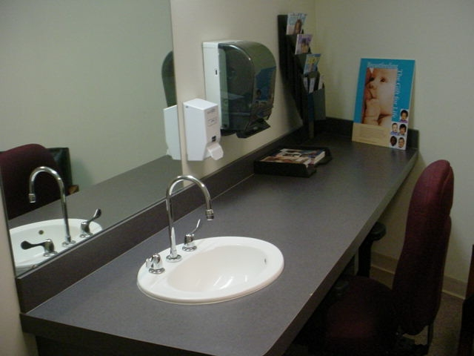
Options for Place: Room Options
Mutual of Omaha
Iowa State Capitol Building
Notes:
Single user

Slide 21
Options for Place: Privacy for Milk Expression
Flexible Options
Construct walls to enclose a small space in a larger room, women’s lounge, or other area
Temporary use of manager office space in settings that lack other spaces with a locking door
A curtained-off area that is not accessible to the public, and meets privacy threshold because of clear, well-communicated policy with co-workers
Privacy panels to block the windows of work vehicles such as patrol cars or construction vehicles on the road and other “On the go” options

Slide 22
Permanent Space—Converted Locker/Shower Rooms
Photo Credit: OWH Employer Solutions
Notes:
A large manufacturing company converted a shower room by closing off the shower portion and using a sink area to provide nursing moms with access to running water.

Slide 23
Flexible Space—Partitions
Photo Credit: OWH Employer Solutions

Slide 24
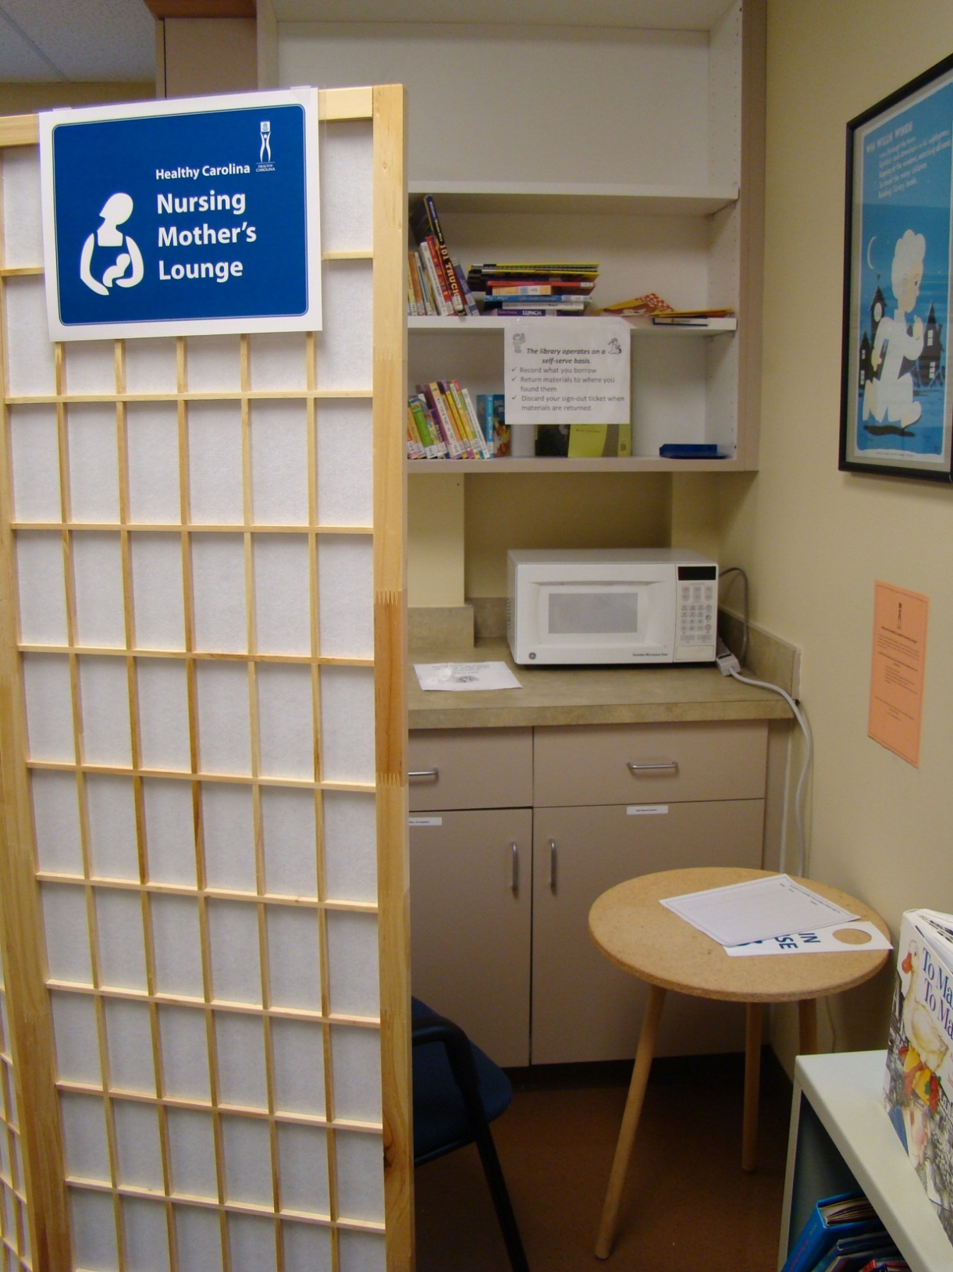
Photo Credit: OWH Employer Solutions

Slide 25
Breast Pump Equipment
Breast pump equipment options:
Employee could bring her own
Employer could purchase or rent a durable pump that more than one mother can use
Employer could provide or subsidize a portable pump designed for working mothers to take to and from work
Employer could research pump supply benefits included in employee benefit plan and provide information to employees prior to leave

Slide 26
Options for Place: Milk Storage Options
Employee could use her own personal cooler
Company could provide a small college dorm room sized refrigerator located in the lactation room
A public shared refrigerator could be used if desired by mothers and co-workers
OSHA regulations state breast milk is not “occupational exposure”

Slide 27
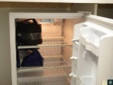
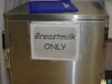
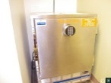
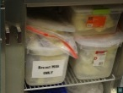
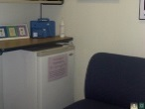
Hygienic Storage
Credit: OWH Employer Solutions

Slide 28
Mother- Friendly Worksite Policy and Program Element Time

Slide 29
Options for Time: Gradual Return to Work
Women need 6 weeks minimum for recovery; 18 weeks is optimal
*Adequate leave could increase breastfeeding enough to prevent 0.6 to 1.0 post neonatal deaths per 1,000 births
Ruhm C. Parental leave and child health. Journal of Health Economics.2000;19:931-960
Notes:
Ruhm (2000) analyzed 25 years of data from 16 European countries to examine this relationship and reported that parental leave entitlements substantially reduce mortality during early childhood. (Ruhm C. Parental leave and child health. Journal of Health Economics.2000;19:931-960.) The availability of one year of job-protected paid leave was associated with nearly a 20% decline in post-neonatal deaths and a 15% decrease in fatalities occurring between year 1 and year 5. Potential mechanisms for this association could be the ability to breastfeed and increased parental involvement.
Having a baby is a leading cause of "poverty spells" in the U.S. -- when income dips below what's needed for basic living expenses.
In the U.S., 49% of mothers cobble together paid leave following childbirth by using sick days, vacation days, disability leave, and maternity leave.51% of new mothers lack any paid leave -- so some take unpaid leave, some quit, some even lose their jobs.
The U.S is one of only 4 countries that doesn't offer paid leave to new mothers -- the others are Papua New Guinea, Swaziland, and Lesotho.
Paid family leave has been shown to reduce infant mortality by as much as 20% (and the U.S. ranks a low 37th of all countries in infant mortality).

Slide 30
Options for Time: Gradual Return to Work
Basic Needs
Gradual phase back to work to allow mother and baby time to adjust to the separation
Flexible Options
Part-time for a period of time
Job sharing
Telecommuting
Flexible scheduling (ex: taking off Wednesdays for a period of time)

Slide 31
Options for Time: Time to Express Milk
Basic Needs
VARIES, but often two to three 15-20 minute breaks during a typical 8-hour work period (plus time to go to and from the site and set up equipment)
Flexible Options
Use regular allotted breaks and lunch period
Excess time that may be needed can be made up before or after work, as part of lunch period, or at other times negotiated with supervisors

Slide 32
Options for Time: Time to Express Milk
Need for milk expression is temporary
As babies begin solid foods the number of sessions often declines
Most women have discontinued expression by 12-15 months
Lunch and routine breaks are often adequate. Options if more time is needed:
Consider extra time paid leave
Come in early or stay later
Continue working while expressing milk

Slide 33
Options for Education
Basic Needs
Prenatal information on breastfeeding
Postpartum assistance in the hospital, at home, and back at work

Slide 34
Options for Education
Flexible Options
Prenatal and postpartum (return to work) breastfeeding class
Informational materials and videos
Company contract with a lactation consultant or other lactation expert to provide prenatal education and postpartum assistance
Individualized back-to-work consult with the contracted lactation expert
Referrals to community classes and lactation experts

Slide 35
Breastmilkcounts.org
Notes:
Check url
Breastmilk counts is an great resource for your employees (nursing mothers) and their families. It provides information on benefits of breastfeeding, how to prepare to breastfeed, and more.

Slide 37
Order Publications and Media
www.dshs.state.tx.us/wichd/WICCatalog/contents.shtm

Slide 38
Promoting the Program
Promotion increases awareness, usage and better Return on Investment (ROI)
Promotion ideas:
Ribbon-cutting event
Coordinate with World Breastfeeding Week (Aug.1-7)
Annual promotion during National Breastfeeding Month (August)
Employee paycheck stuffers
Include information in new employee orientation
Posters and fliers
Employee newsletters
Table tents in lounge and cafeteria areas
Stickers in bathrooms
Employee health fairs and wellness events

Slide 39
Options for Support: Managers
Top-level support company leaders/workers
Rationale for a lactation program
Expectations of support
No tolerance for inappropriate jokes, comments
Lactation support policies
Training for supervisors

Slide 40
Options for Support: Peers
Common concerns:
Coverage when employees express milk
Discomfort with topic
Unaware of lactation benefits
Strategies for gaining support:
Involve co-workers in initial planning
Promote as a company health benefit
Promote lower absenteeism and turnover rates
Maintain ongoing communication
Co-workers with children may be most supportive

Slide 41
Best Practice Steps for Policy and Program Development
Seek executive level support
Convene, orient, and engage workgroup
Conduct a worksite needs assessment
Weigh needs, options, resources, and constraints and develop a program plan
Develop and implement policy and program components to create a supportive environment
Track program indicators and evaluate outcomes on an ongoing basis
Reassess on regular schedule

Slide 42
Contact us to learn more! (903) 535-0020 ContactUs@netphd.org
OR
(903) 593-8331
tecora.smith@nhwic.org
bonnie.barker@nhwic.org
Notes:
Be recognized for your lactation support program
Learn best practices for lactation support programs

